Slide 1







IBM Data Analyst Capstone Project
Harshit Verma
18 August 2021

Slide 2



OUTLINE
Executive Summary
Introduction
Methodology
Results
Visualization – Charts
Dashboard
Discussion
Findings & Implications
Conclusion
Appendix

Slide 3

EXECUTIVE SUMMARY
Collecting Data using APIs and Web Scrapping
Using a publicly available dataset from stackoverflow
For exploring pandas library
Data Wrangling
Exploratory Data Analysis
Data Visualization using matplotlib and seaborn
Building A Dashboard using IBM Cognos

Slide 4

INTRODUCTION
Collecting Job data and popular language data
Analysing and normalizing the data
Visualizing data for future trends
Conclusion
What are highest paid job profiles
What language, database, platform will be popular in the future

Slide 5

METHODOLOGY
Using Web Scraping and publicly available dataset from different sources
Using pandas and numpy libraries for data analysis
Using matplotlib and seaborn for data visualization
Using IBM Cognos for dashboard generation
Dashboard 3 for insights about jobs
Dashboard 1 and 2 for insights on popular technologies

Slide 6
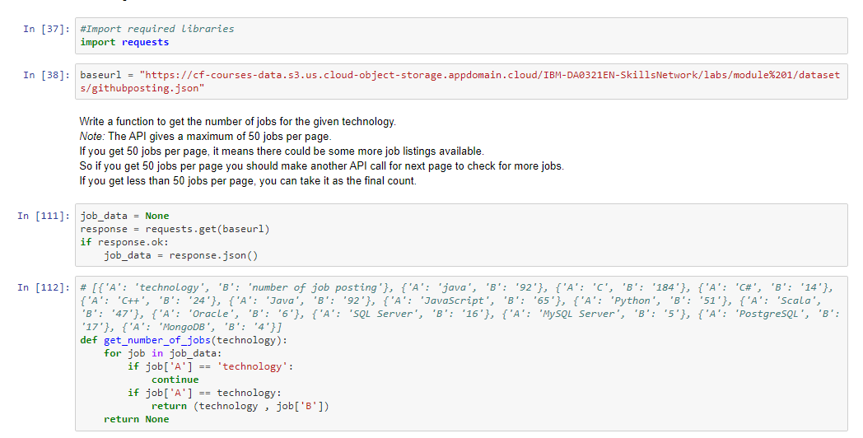
RESULTS
Using API for extracting data

Slide 7
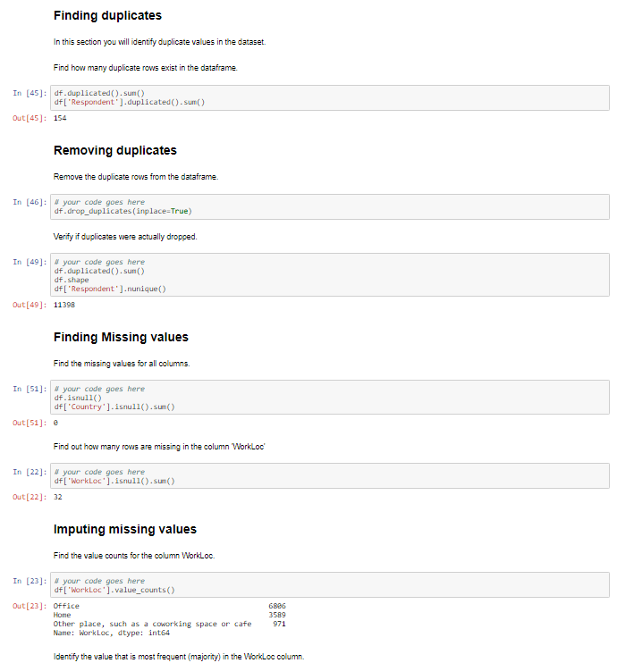
RESULTS
Data Wrangling

Slide 8
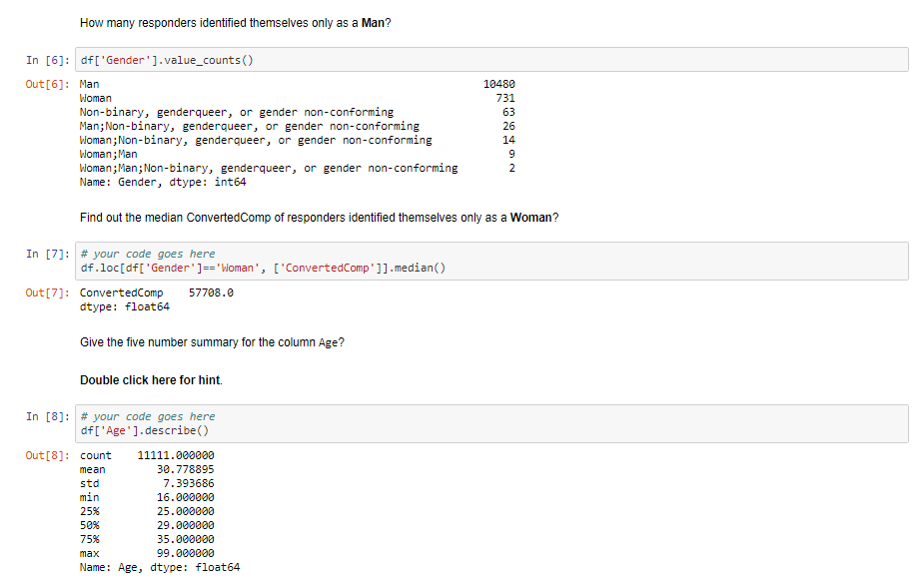
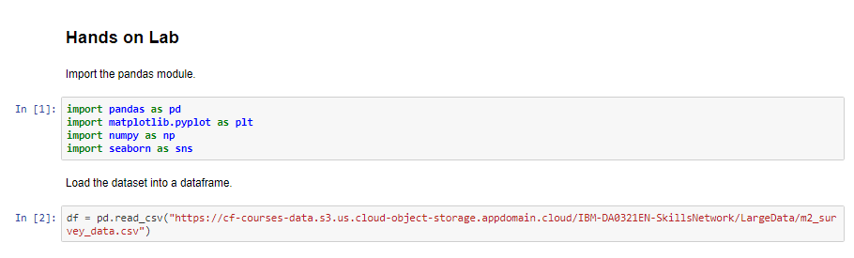
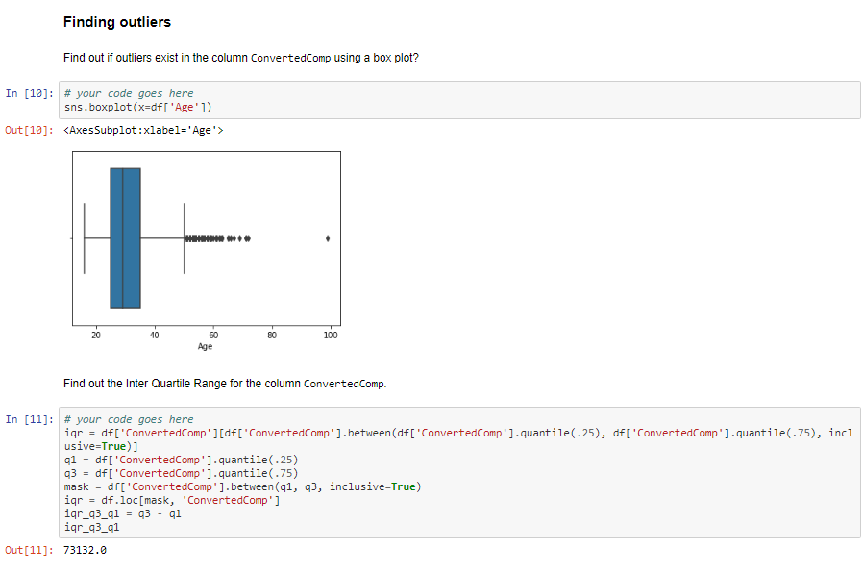
RESULTS
Exploratory Data Analysis

Slide 9
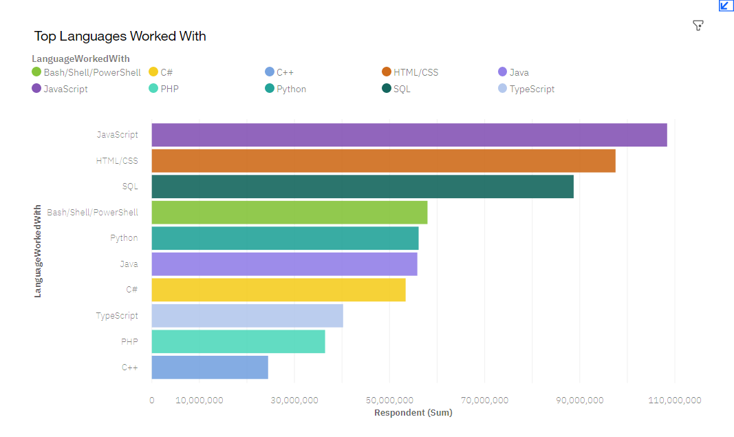
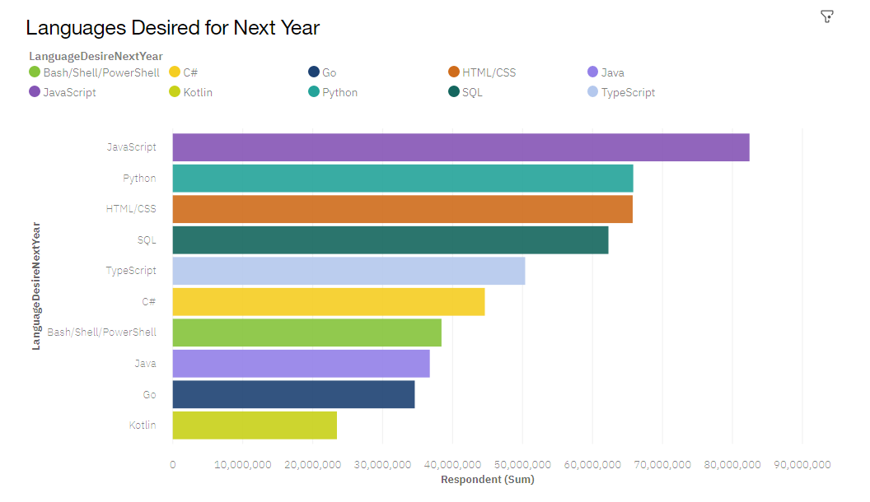
PROGRAMMING LANGUAGE TRENDS
Current Year
Next Year
<Bar chart of top 5 programming languages for the current year goes here.>
< Bar chart of top 5 programming languages for the next year goes here.>

Slide 10
PROGRAMMING LANGUAGE TRENDS - FINDINGS & IMPLICATIONS
Findings
Web development languages are most popular
JavaScript, Html/CSS are used by majority
Python is most popular development language
Implications
High competition as most people work in web development
Starting with Html/CSS, JavaScript is a good idea
Learn Python if you are interested in development

Slide 11
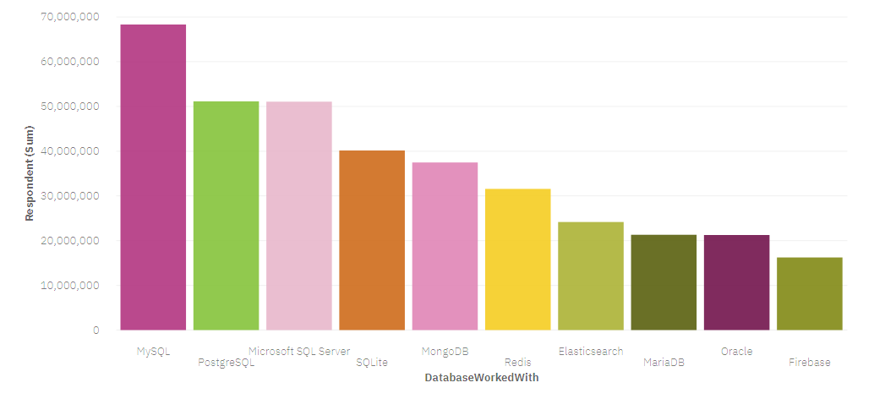
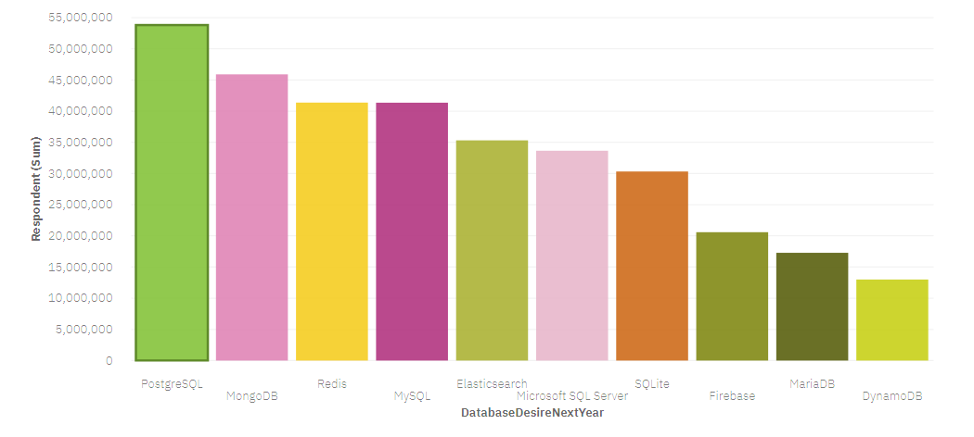
DATABASE TRENDS
Current Year
Next Year

Slide 12
DATABASE TRENDS - FINDINGS & IMPLICATIONS
Findings
MySQL is most popular language currently
MongoDB and Redis are not most popular
Microsoft SQL Sever is one of the most popular database
Implications
MySQL will be replaced by PostgreSQL next year
MongoDB and Redis will be becoming popular in the future
Microsoft SQL will slowly lose its popularity

Slide 13

DASHBOARD
Link for the dashboard created with the help of IBM Cognos
IBM Cloud Pak for Data

Slide 14
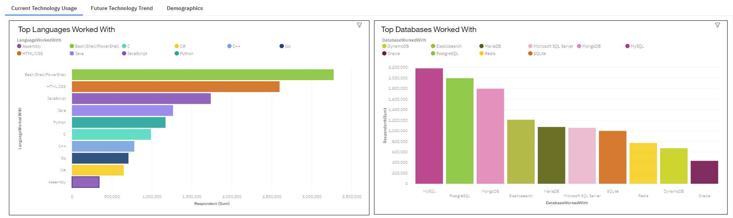
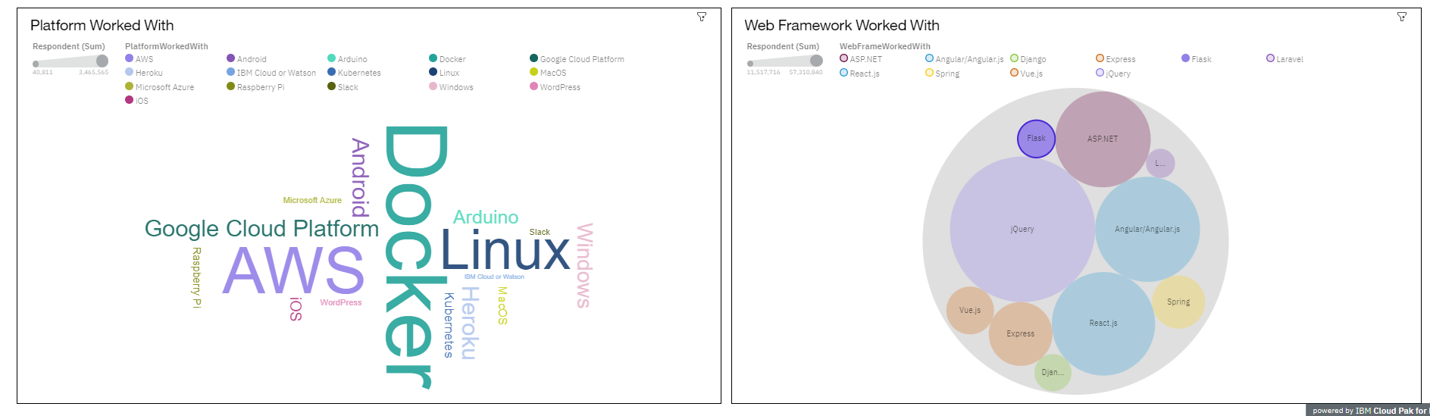
DASHBOARD TAB 1
Screenshot of dashboard tab 1 goes here

Slide 15
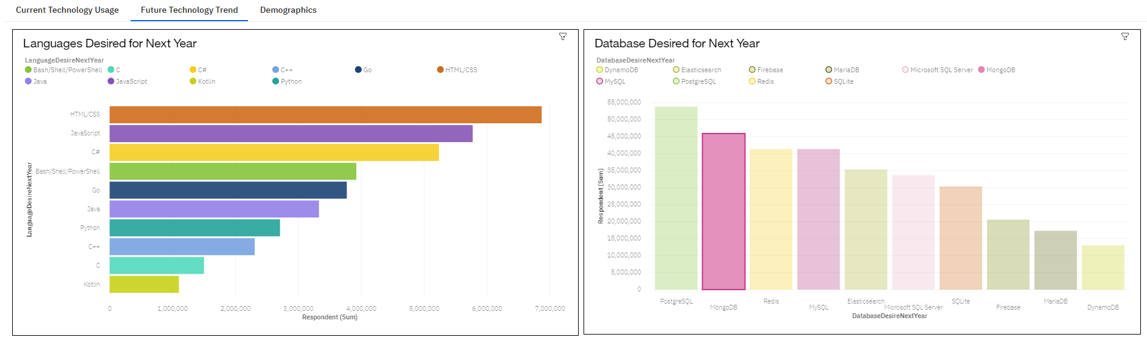
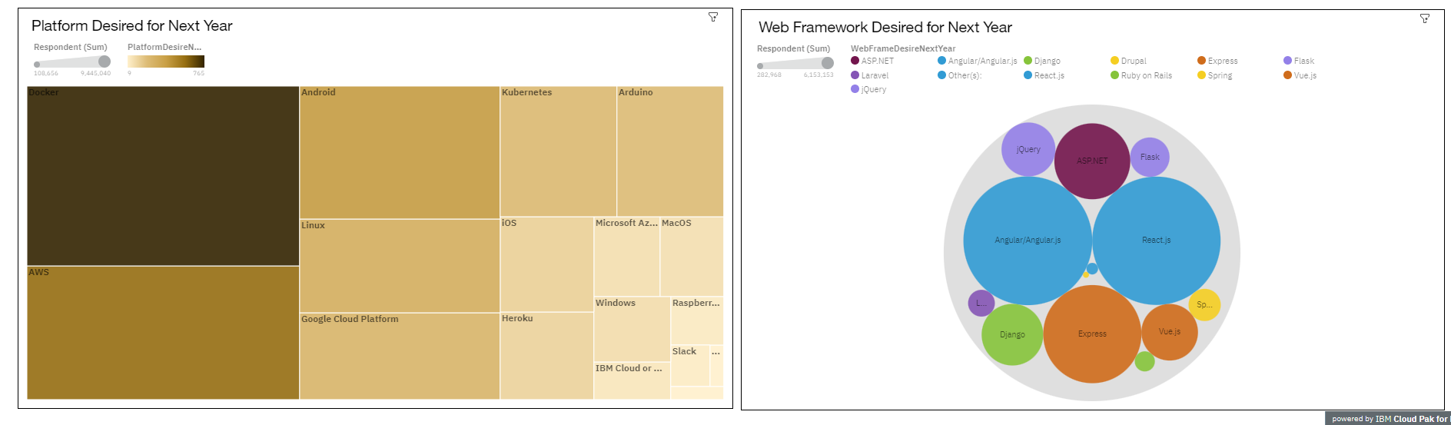
DASHBOARD TAB 2
Screenshot of dashboard tab 2 goes here

Slide 16
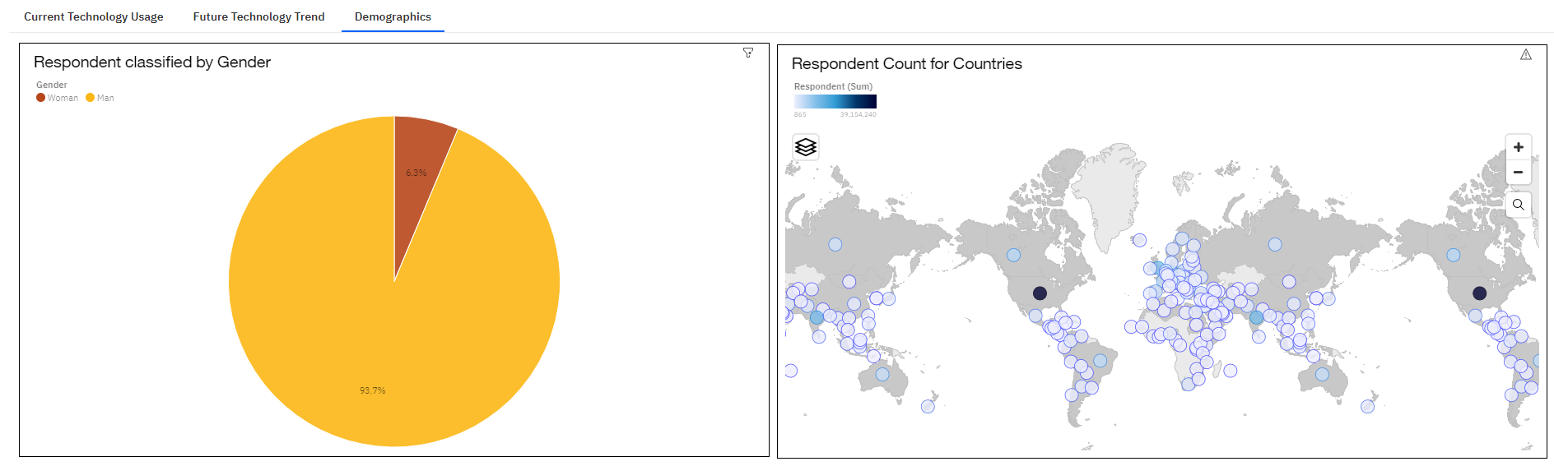
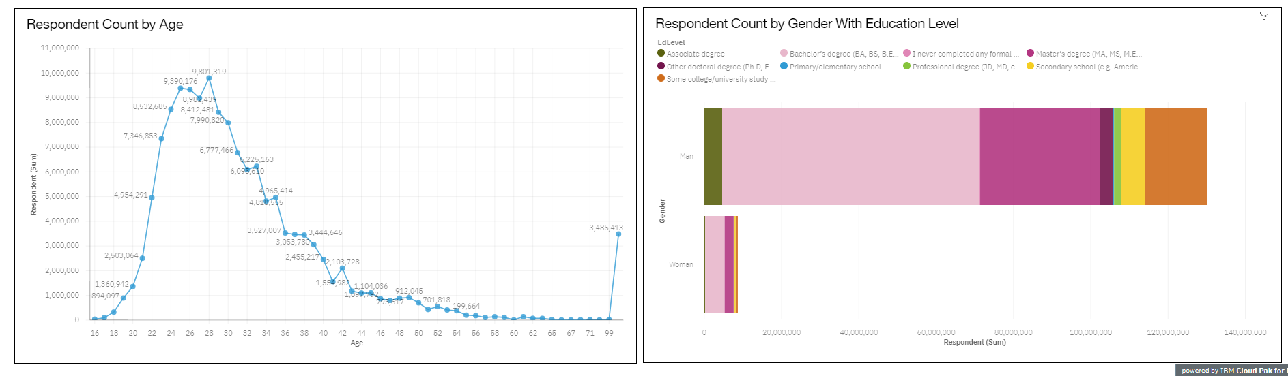
DASHBOARD TAB 3
Screenshot of dashboard tab 3 goes here

Slide 17
DISCUSSION
Best languages for college graduates to learn are JavaScript, HTML/CSS, Python, SQL.
Best databases for college graduates to learn are PostgreSQL, MongoDB, Redis
Best Platform for college graduates to learn are Linux, AWS, Windows

Slide 18
OVERALL FINDINGS & IMPLICATIONS
Findings
JavaScript, HTML/CSS are widely used for web development
Python, SQL are widely used for data analysis
Widely used platforms for development are Linux, AWS, Windows
Implications
Learning JavaScript, HTML/CSS is beneficial
Learning Python, SQL are important for data scientist
Having basic knowledge of Linux, AWS, Windows is important

Slide 19

CONCLUSION
Technology trends change rapidly with time.
Keep learning about new technologies is important for growing in the field of technology
Python, HTML/CSS are by far the most important languages to learn
Learning language which is not very popular can land you a good job.

Slide 20

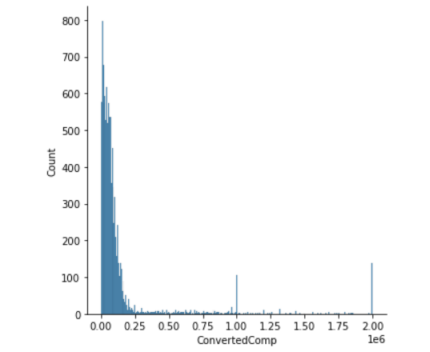
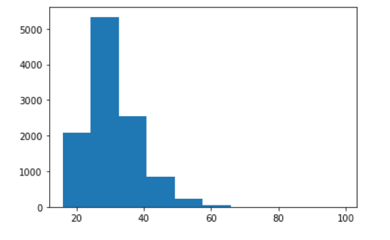
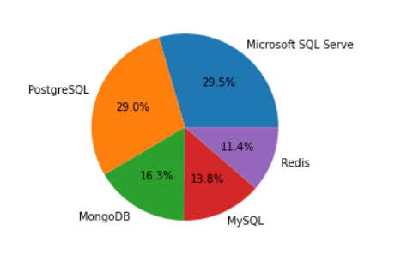
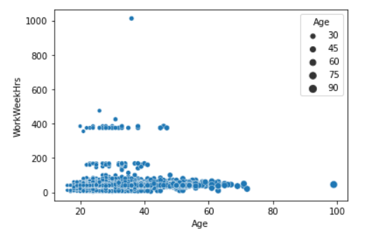
APPENDIX
Distribution Plot
Histogram Plot
Include any relevant additional charts, or tables that you may have created during the analysis phase.
Pie Chart
Scatter Plot

Slide 21
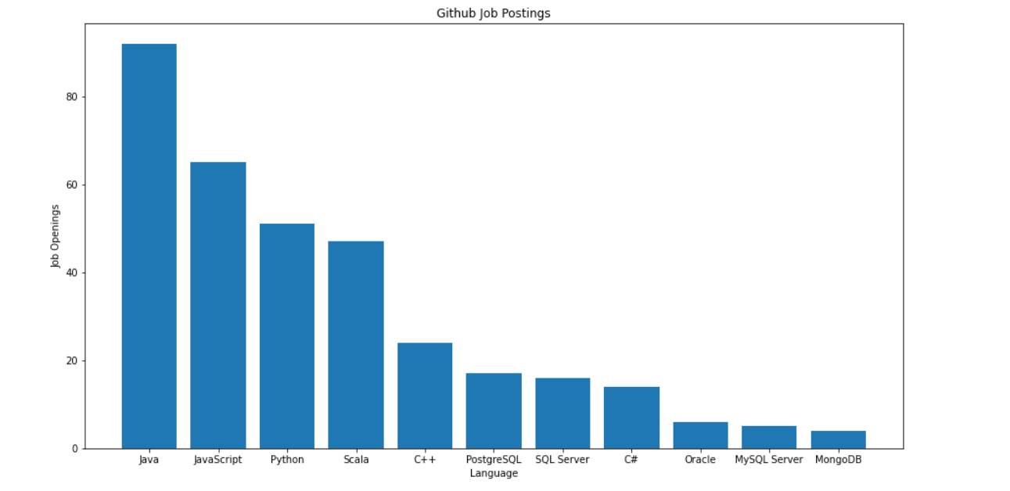
GITHUB JOB POSTINGS
In Module 1 you have collected the job postings data using GitHub API in a file named “github-job-postings.xlsx”. Present that data using a bar chart here. Order the bar chart in the descending order of number of job postings.

Slide 22
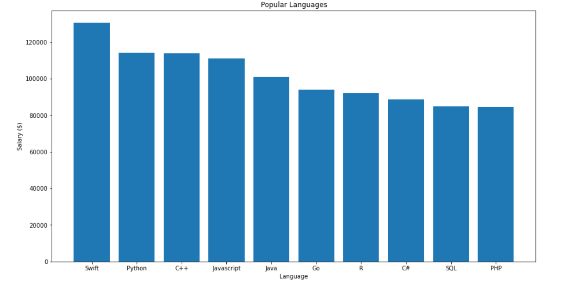
POPULAR LANGUAGES
In Module 1 you have collected the job postings data using web scraping in a file named “popular-languages.csv”. Present that data using a bar chart here. Order the bar chart in the descending order of salary.

